Slide 1



The Beauty and Joy of Computing Lecture #13
Internet I
Jonathan
McKinsey
Jon’s Recipe for Success in College (and Beyond)
Form study groups. Learn from and teach your peers.
Get a github account and start building your portfolio.
Learn the difference between confidence and arrogance.
Be thinker and not a drone.
Exercise and eat right.
Stay up-to-date in your field. Join professional societies.
Give back to the community.

Slide 2
Internet History

Slide 3


(AP) Computer Science Principles
7 Big Ideas
Creativity
Abstraction
Data and Information
Algorithms
Programming
The Internet
Global Impact

Slide 4
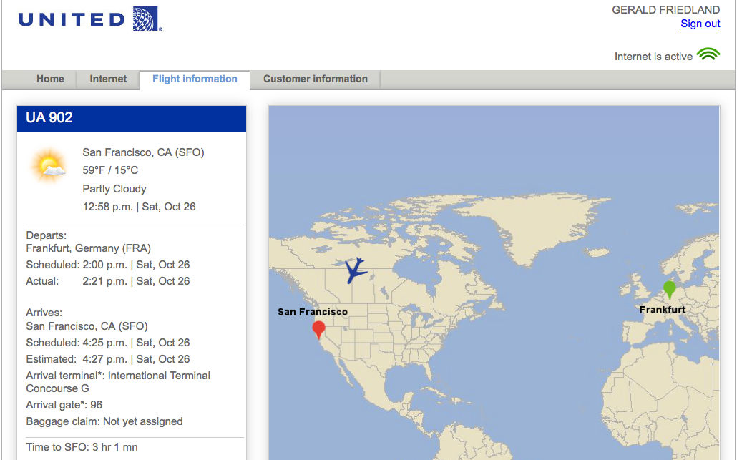
Internet is pretty much everywhere! (1/2)
Notes:
Data and information is hard to define. There are philosophical and meta-physical issues. So let’s all watch the Matrix…

Slide 5
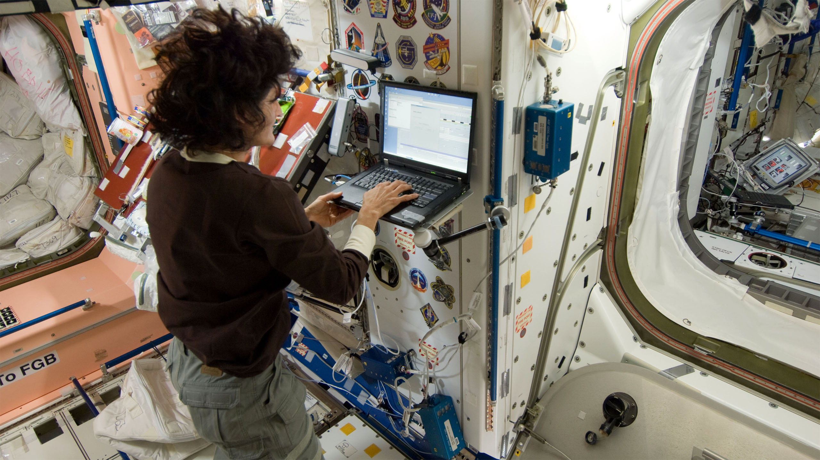
Internet is pretty much everywhere! (2/2)
Astronaut using the Internet on the International Space Station
Source: NASA
Notes:
Data and information is hard to define. There are philosophical and meta-physical issues. So let’s all watch the Matrix…

Slide 6
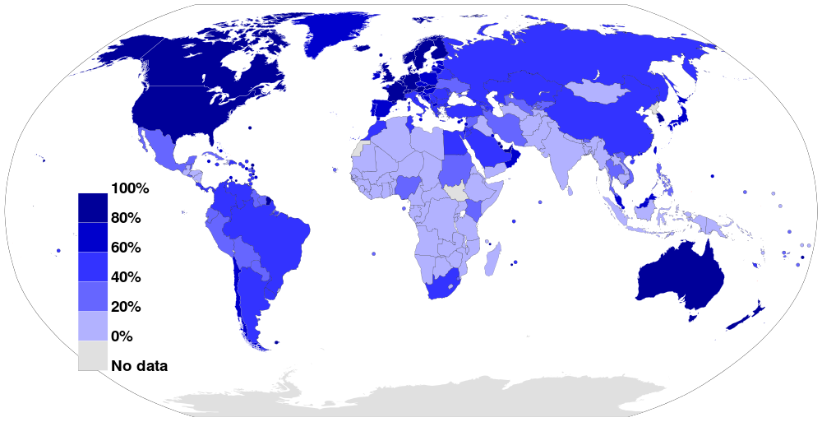
The Internet Today
Internet Usage as a Percentage of Population (2012)
Source: Wikimedia Commons

Slide 7
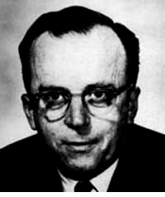
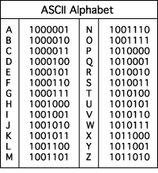
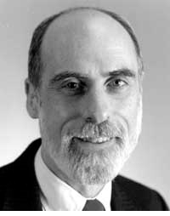
The Internet (1962)
en.wikipedia.org/wiki/Internet_Protocol_Suite
www.computerhistory.org/internet_history
www.greatachievements.org/?id=3736
1962: JCR Licklider, as head of Defense Advanced Research Projects Agency (ARPA), writes on “intergalactic network” where everyone on the globe is interconnected and can access programs and data at any site from anywhere
1963 : ASCII (American Standard Code for Information Interchange) becomes first universal computer standard
128 characters: a-z, A-Z, 0-9, space, some punctuation, and some control characters
1969 : Defense Advanced Research Projects Agency (DARPA) deploys 4 “nodes” @ UCLA, SRI, Utah, & UCSB that form ARPANET
1973 Robert Kahn & Vint Cerf invent TCP, now part of the Internet Protocol Suite
Licklider
Vint Cerf
☑

Slide 8
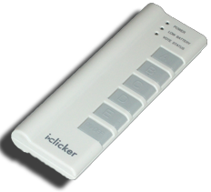
Quick Question I
In the last 3 years, what was the longest time stretch you have ever been without Internet?
Several hours
1-2 days
More than 2 days
Several weeks
More than several weeks
Notes:
Data and information is hard to define. There are philosophical and meta-physical issues. So let’s all watch the Matrix…

Slide 9
Quick Question II
What was the reasons for not having access to the Internet?
Technical interruption
In an area with no Internet
Voluntary break
Didn’t bother having access
Other
Notes:
Data and information is hard to define. There are philosophical and meta-physical issues. So let’s all watch the Matrix…

Slide 10
Internet How it Works

Slide 11

The basics of the basics
youtu.be/7_LPdttKXPc
Notes:
40% of the Internet traffic is YouTube alone!

Slide 12

It’s a Network of Autonomous Systems (1)
en.wikipedia.org/wiki/End-to-end_principle
The Internet and the systems built on it facilitate collaboration.
The Internet connects devices and networks all over the world i.e. the Internet of Things.
An end-to-end architecture facilitates connecting new devices and networks on the Internet.
This means all the hard work (e.g., checking if a file is corrupted) is done by the endpoints, and the middle network is “dumb”, “unreliable”, “dynamic”
Software-Defined Networking (SDN) and Cloud Computing are changing this!
Connecting new devices to the Internet is enabled by assignment of an Internet protocol (IP) address.
The domain name system (DNS) translates names to IP addresses.

Slide 13
It’s a Network of Autonomous Systems (2)
en.wikipedia.org/wiki/End-to-end_principle
The Internet is built on evolving standards, including those for addresses and names.
We’ll see how IP has changed, new “top-level” domain names added!
Devices & networks that make up the Internet are connected and communicate using addresses and protocols.
Protocols = agreements on standards
Standards such as hypertext transfer protocol (HTTP), IP, and simple mail transfer protocol (SMTP) are developed and overseen by the Internet Engineering Task Force (IETF).

Slide 14
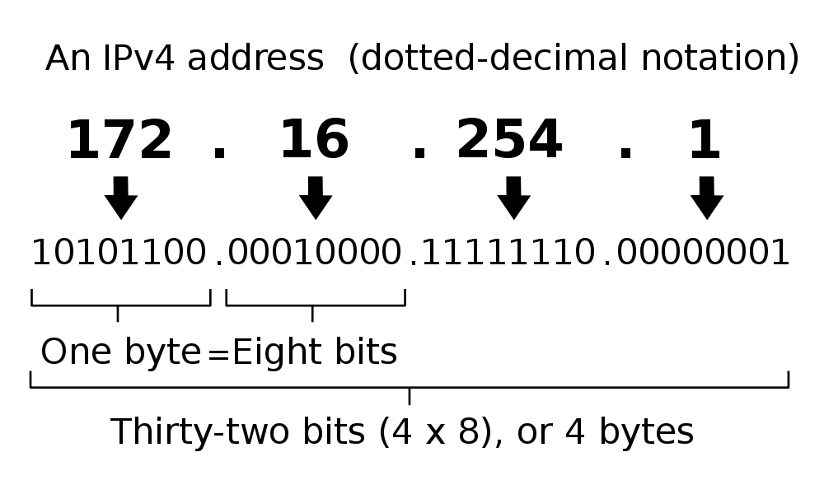
IP Addresses (this one is called IPv4)
en.wikipedia.org/wiki/IPv6
2³² = ~4 billion unique numbers (world population 7 billion)

Slide 15
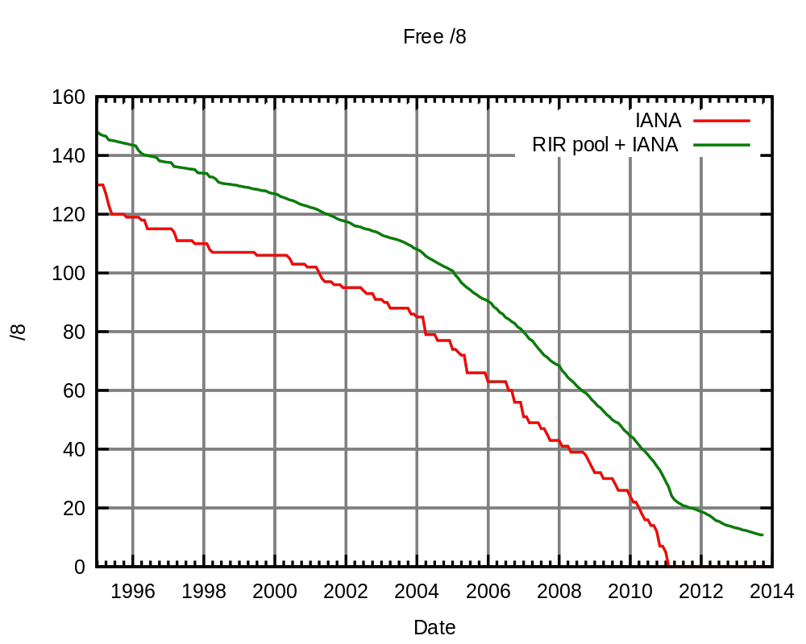
Problem: No more IP addresses left…
en.wikipedia.org/wiki/IPv4_address_exhaustion
1 global Internet Assigned Numbers Authority (IANA)
5 regional Internet registries (RIR)
Source: Wikimedia Commons
Notes:
Internet Assigned Numbers Authority (IANA) globally, and by Internet Assigned Numbers Authority (IANA) globally

Slide 16
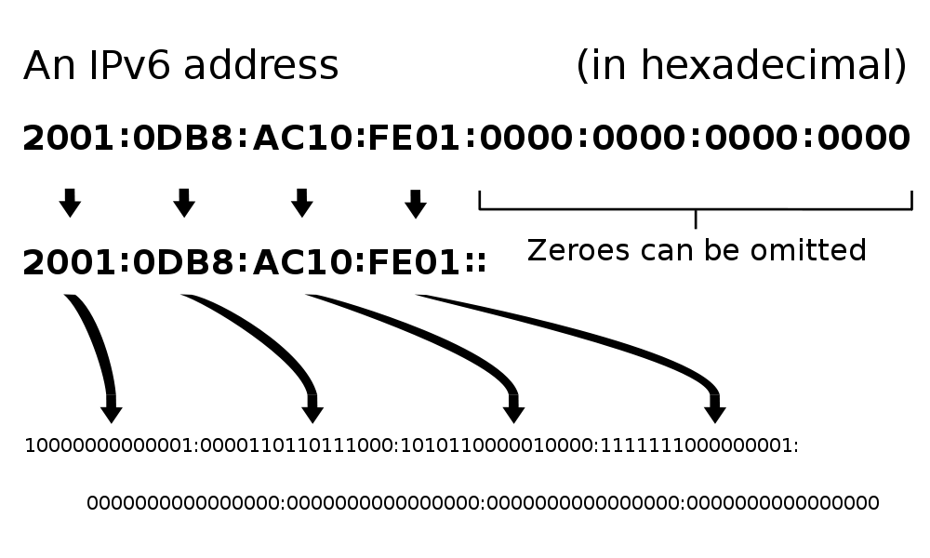
Solution: IPv6
en.wikipedia.org/wiki/IPv6
2¹²⁸ = 3.403 x 10³⁸ unique addresses
Issue: Adoption still in progress
Band-aid fix: Network Address Translation
☑

Slide 17
Count
Take a moment and count: How many Internet-connected devices do you own?
0
1
2-5
5-10
More than 10
Notes:
Data and information is hard to define. There are philosophical and meta-physical issues. So let’s all watch the Matrix…

Slide 18
Internet Applications

Slide 19
Email (1965)
en.wikipedia.org/wiki/Email
Fundamentally changed the way people interact!
1965: MIT’s CTSS
Compatible Time-Sharing Sys
Exchange of digital info
Model: “Store and Forward”
“Push” technology
Pros
Solves logistics (where) & synchronization (when)
Cons
“Email Fatigue”
Information Overload
Loss of Context
How
Alice composes email to bob@b.org
Domain Name System looks up where b.org is
DNS server with the mail exchange server for b.org
Mail is sent to mx.b.org
Bob reads email from there

Slide 20
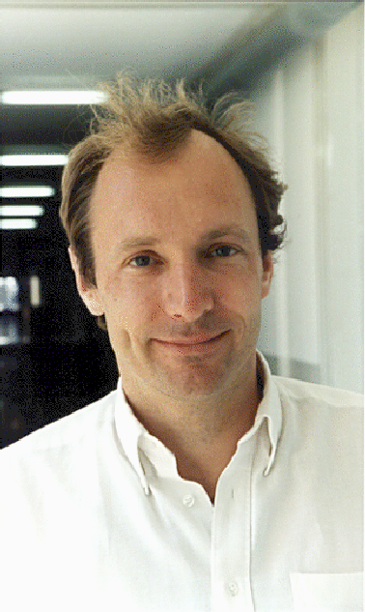
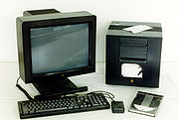

The World Wide Web (1989)
en.wikipedia.org/wiki/History_of_the_World_Wide_Web
“System of interlinked Internet hypertext documents”
History
1945: Vannevar Bush describes hypertext system called “memex” in article
1989: Tim Berners-Lee proposes, gets system up ’90
~2000 Dot-com entrepreneurs rushed in, 2001 bubble burst
Wayback Machine
Snapshots of web over time
Today : Access anywhere!
World’s First web server in 1990
Tim Berners-Lee
www.archive.org

Slide 21
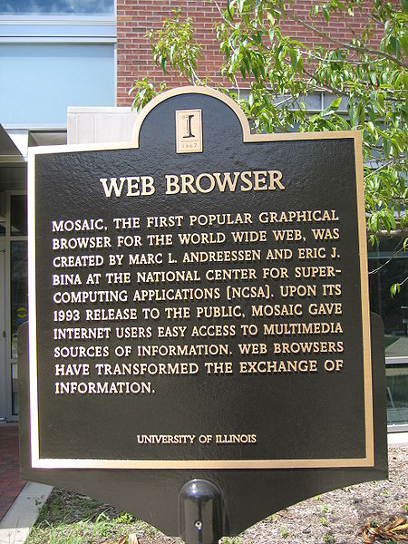


WWW Search & Browser (1993)
en.wikipedia.org/wiki/History_of_the_web_browser
Browser
Marc L. Andreesen and Eric J. Bina @ NCSA create Mosaic, 1st popular WWW browser
First Internet “Killer App”
Later: Netscape Navigator
Now Chrome, IE, Firefox, Safari, Opera, etc
Search
Before engines, there was a complete list of all servers!
1993 Martijn Koster Aliweb is 1st web search engine
1997 Stanford Sergey Brin and Larry Page develop Google’s search, based on PageRank

Slide 22
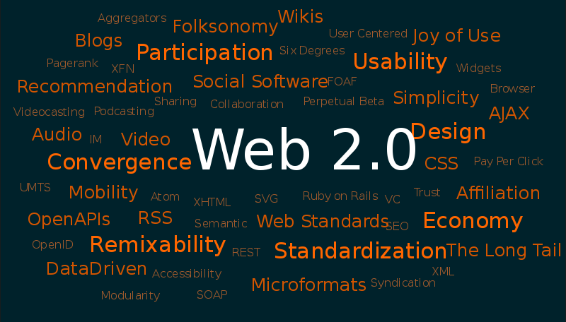
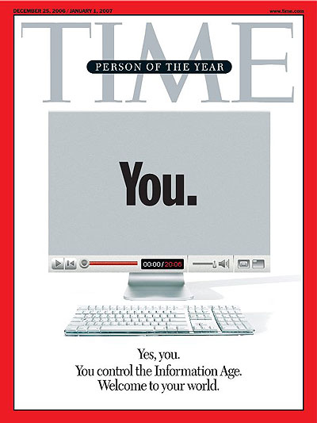
Web 2.0 : The Social Network (2004)
en.wikipedia.org/wiki/Web_2.0
“…web development & design that facilitates interactive information sharing, interoperability, user-centered design and collaboration on WWW”
Users change content via “architecture of partipation”
Examples
Web communities, apps, social networks, video & photo sharing, wikis, blogs, tweets, …
“Take back the web!”
“You” – Time’s 2006 Person of the Year
☑

